Slide 1
Stock trading strategy based on Neural networks
HKU Msccs 3035249227
ZHAN Hui

Slide 2
content
Purpose
System structure
Convert to tradable strategies
Current NN

Slide 3
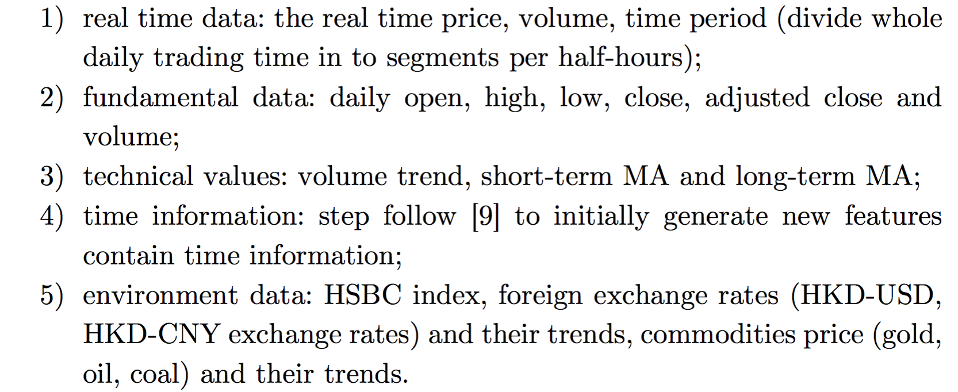
1. Purpose
Learn from historical trading information to recommend trading strategies for a specific market situation:
Input:
Meanwhile training out well performance NN and using it to predict price trend.

Slide 4
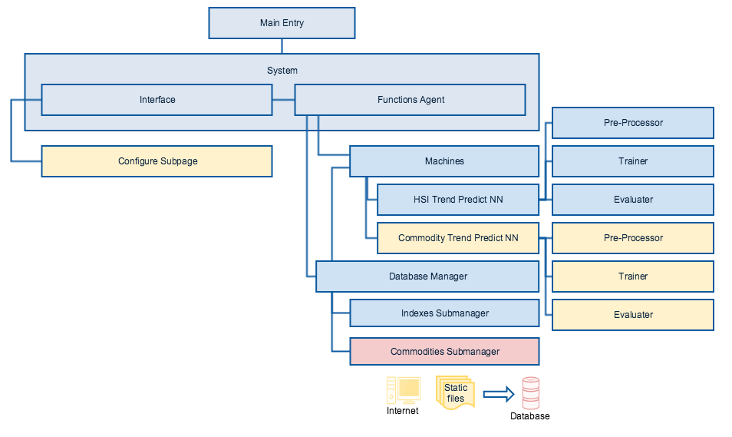
2. System structure
degree red : develop now;
degree yellow : planned to develop next step;
degree blue : developed.

Slide 5
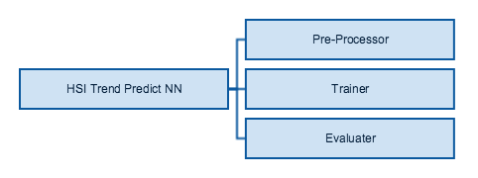
3. Convert to tradable strategies
Separate the part of well performance to do trend predict.

Slide 6
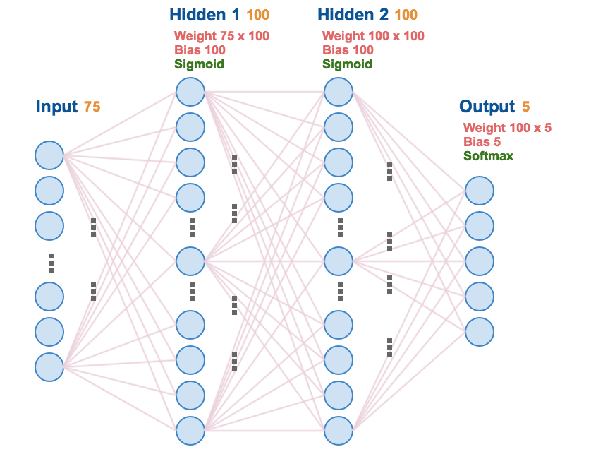
4. Current NN
HSI daily trend predict NN.
Structure:

Slide 7
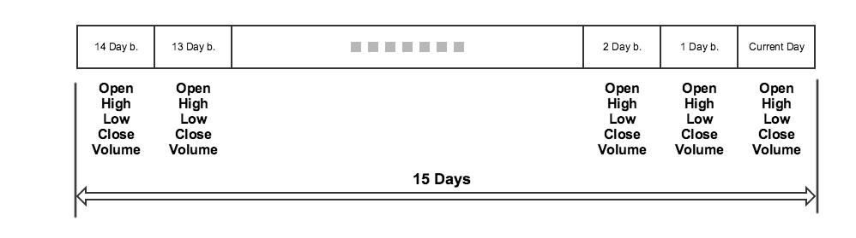
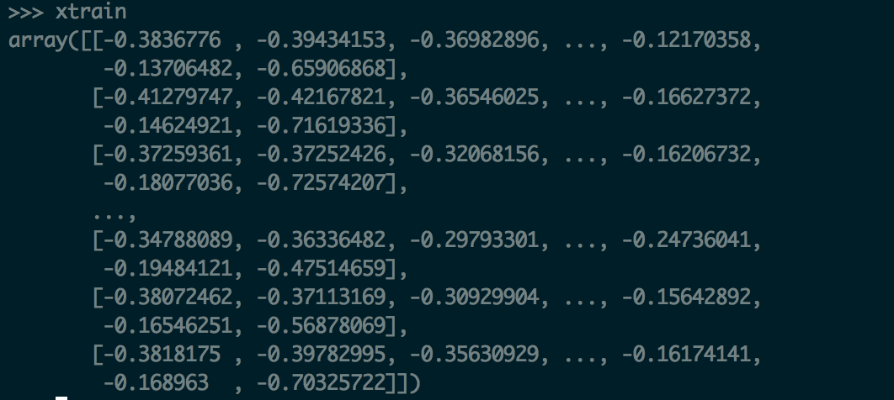
4. Current NN
Input:
15 days’ OHLCV data (1 year).
Preprocess the data, making of data in the range of [-1,1].

Slide 8
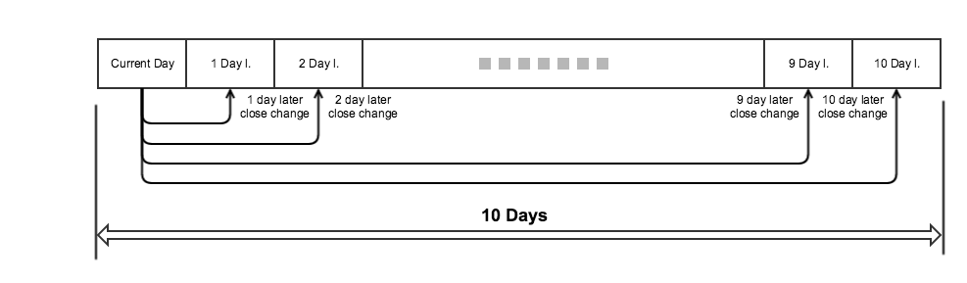
4. Current NN
Output(labels):
10 days’ close price change rate.
Preprocess the data, dividing the change rate into 5 classes, namely DU-dramatic up, U-up, F-fluctuate, D-down and DD-dramatic down.
E.g. [1,0,0,0,0] means DU; [0,0,1,0,0] means F.

Slide 9
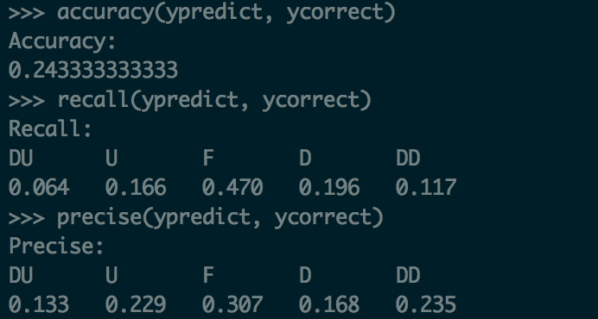
4. Current NN
Result:
Use accuracy, recall and precise to evaluate the NN.
That means the current NN performs bad.

Slide 10
4. Current NN
Improvement:
Try to use longer training data (e.g. 3 years); shorter training data (e.g. 5 months);
Try to use different label mechanism (e.g. 2/3 classes);
Try to use different Input data (e.g. remove OHL price and rest close price and volume only);
Try to add some new features (e.g. SMA indicators);
Try add more hidden layers/neurons.
Most Interested:
Try another NN, current NN is a simple forward propagation NN, try implement RNN and CNN.

Slide 11
The end Thanks

